Slide 1


EMPLOYEE DATA ANALYSIS USING EXCEL
Student Name: Divyashree.S
Register No: 312216323
NM Username: asunm1621312216323
NM ID: 2FFB30B75E51B8B97514CC0B5FC0C40B
Department: III Year B.Com [General] - B, Shift - 2
College: Shri Shankarlal Sundarbai Shasun Jain College for Women, T.Nagar, Chennai

Slide 2

PROJECT TITLE
Employee Salary-Analysis using Excel

Slide 3
AGENDA
Problem Statement
Project Overview
End Users
Solution and its Value Proposition
Dataset Description
Modelling Approach
Results and Discussion
Conclusion

Slide 4
1. PROBLEM STATEMENT
The problem statement is to analyse the employee salary data to understand salary trends and identify inconsistencies or disparities.
The goal is to evaluate how salaries compare across different departments, divisions, and gender.
To provide insights to help ensure fair and competitive compensation within the organisation.

Slide 5

2. PROJECT OVERVIEW
This project aims to analyse employee salary data to identify salary trends and disparities.
Steps are taken to review and clean the dataset, calculate key statistics, and compare salaries across different departments and roles.
The goal is to provide insights and recommendations for improving salary equity within the organization.

Slide 6

3. END USERS
The End Users of this Employee Salary Analysis are:
HR Managers
Finance Team
Management
Department Heads
External Auditors
Employees
Legal Advisors
Data Analysts
Board of Directors
Strategic Planners

Slide 7

4. SOLUTION AND ITS VALUE PROPOSITION
Pivot Table – Used to extract the needful data from the Raw Excel Data to do Analysis.
Line Graph Chart – Comparison is done for Base Salary using various Departments.
Doughnut Chart – Comparison of Overtime Pay.
100% Stacked Column Chart – Comparison of Longevity Pay.
Sparklines – Comparison of Grades.

Slide 8
5. DATASET DESCRIPTION
Employee Dataset taken from Kaggle.
Employee ID:
Type - Alphanumeric
Description - Unique identifier for each employee.
2. Department:
Type - Text Abbreviation
Description - Code of the Department.
3. Department Name:
Type - Text
Description - The department in which the employee works.
4. Division:
Type - Text
Description - The Division under the Department.

Slide 9
5. DATASET DESCRIPTION
5. Gender:
Type - Text
Description - Male / Female.
6. Base Salary:
Type - Numeric
Description - The fixed amount of compensation an employee receives before any additional earnings such as bonuses, commissions, or benefits.
7. Overtime Pay:
Type - Numeric
Description - Additional compensation earned by employees for working beyond their standard work hours, typically calculated at a higher rate than the regular hourly wage.

Slide 10
5. DATASET DESCRIPTION
8. Longevity Pay:
Type - Numeric
Description - Additional compensation is given to employees based on the length of their service with an organization, often as a reward for long-term employment.
9. Grade:
Type - Alphanumeric
Description - A classification or level assigned to an employee based on their job role, responsibilities, and experience, often used to determine salary ranges, benefits, and promotion criteria.

Slide 11

THE “WOW” IN THE SOLUTION
The “Wow” in the solution is making use of different types of graphs for each type of data to understand the data in a better way.
Use of Sparklines for Grade of Employees based on Salaries, the high point is coloured as green and the low point as red, so that viewers can easily note - THE GRADE OF MAJORITY OF EMPLOYEES IN A PARTICULAR DEPARTMENT.

Slide 12
6. MODELLING APPROACH
Step 1: Take a Dataset from Kaggle
I downloaded a dataset from Kaggle which gave me the details of the Employees and their Salary Amounts. I converted the dataset from .csv format to .xlsx format to work with the data in Excel.
Step 2: Work on the Raw Dataset
In Excel, based on the Departments, I gave unique Employee ID codes. Using the =COUNTA() function, the total number of employees was calculated. Since the range of the Base Salary, Overtime Pay and Longevity Pay was large and would not be properly depicted in the chart, I converted the amounts to – (Rs. in Lakhs).
I also graded the Employees to know the slab of Income they fall under by using =IFS() function.

Slide 13
6. MODELLING APPROACH
Step 3: Data Analysis through Pivot Tables
Next, I created the 4 Pivot Tables separately for Base Salary, Overtime Pay, Longevity Pay and the Grade of the Employees. During this process, I used various functions like =MIN(), =MAX(), =COUNT(), =SUM() etc.
Step 4: Data Visualization through Different Kinds of Charts
Based on the information from the Pivot Table, I created different charts as follows: Base Salary – Line Chart
Overtime Pay – Doughnut Chart
Longevity Pay – 100% Stacked Column Chart
Grade of Employees – Sparklines
Step 5: Gave Appropriate Results and Conclusion
With the help of the information, I gave proper Results, conclusions and suggestions.

Slide 14
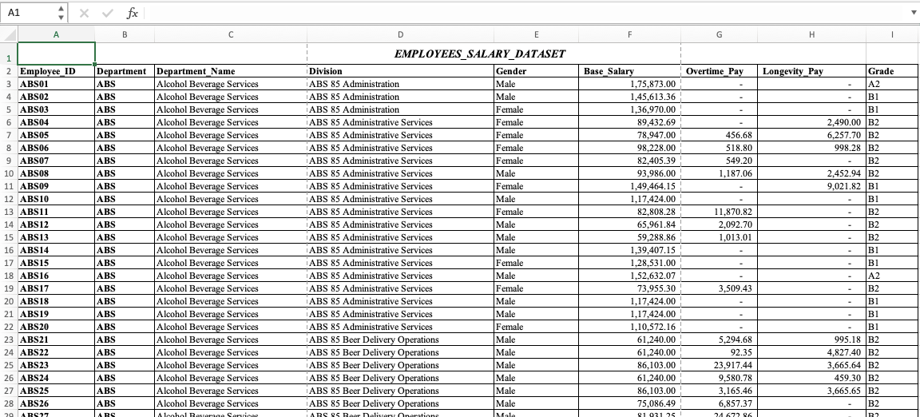
6. MODELLING APPROACH
RAW EXCEL DATA

Slide 15
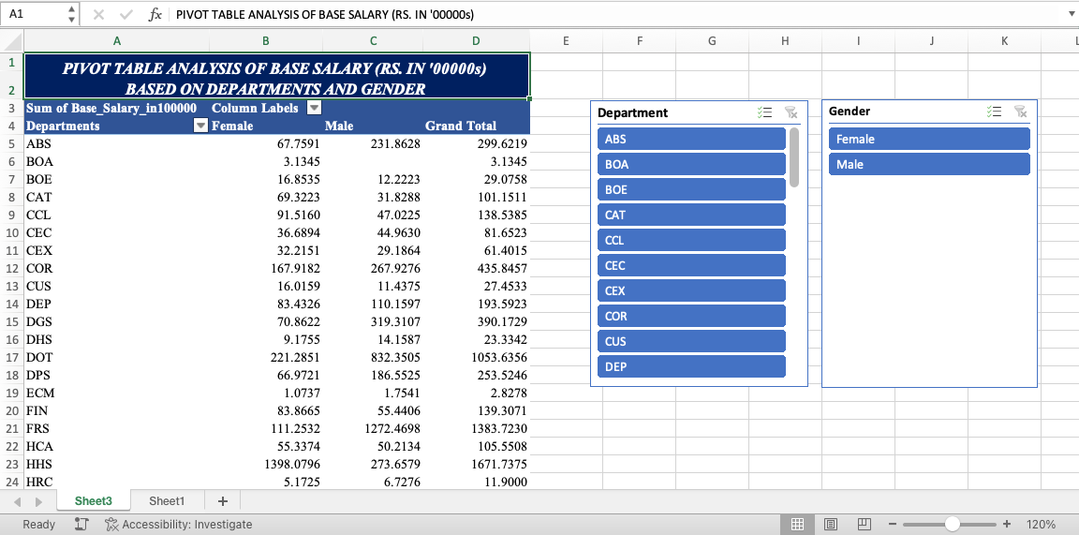
6. MODELLING APPROACH
PIVOT TABLE WITH SLICERS - BASE SALARY

Slide 16
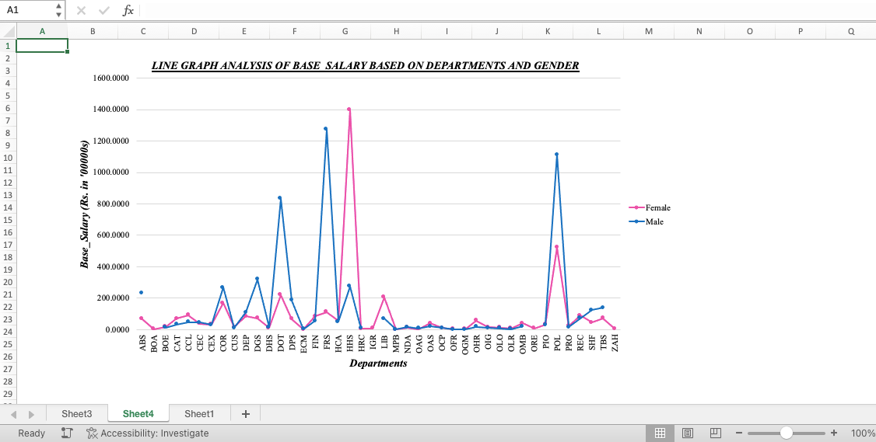
6. MODELLING APPROACH
LINE GRAPH ANALYSIS - BASE SALARY

Slide 17
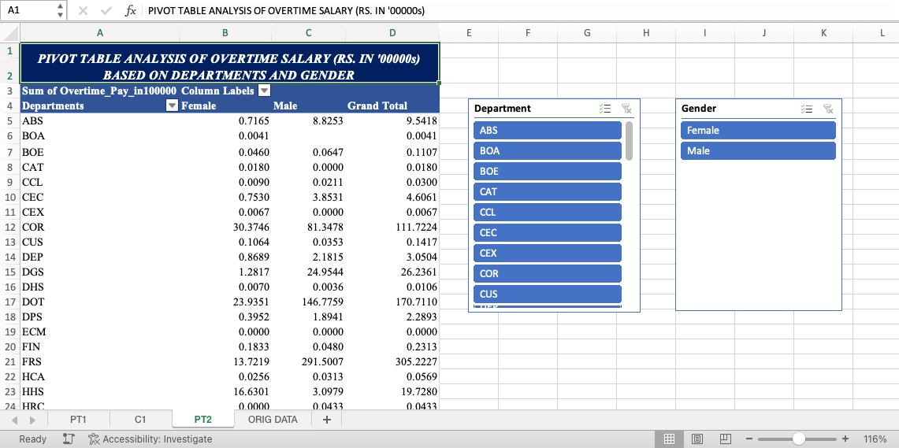
6. MODELLING APPROACH
PIVOT TABLE WITH SLICERS - OVERTIME PAY

Slide 18
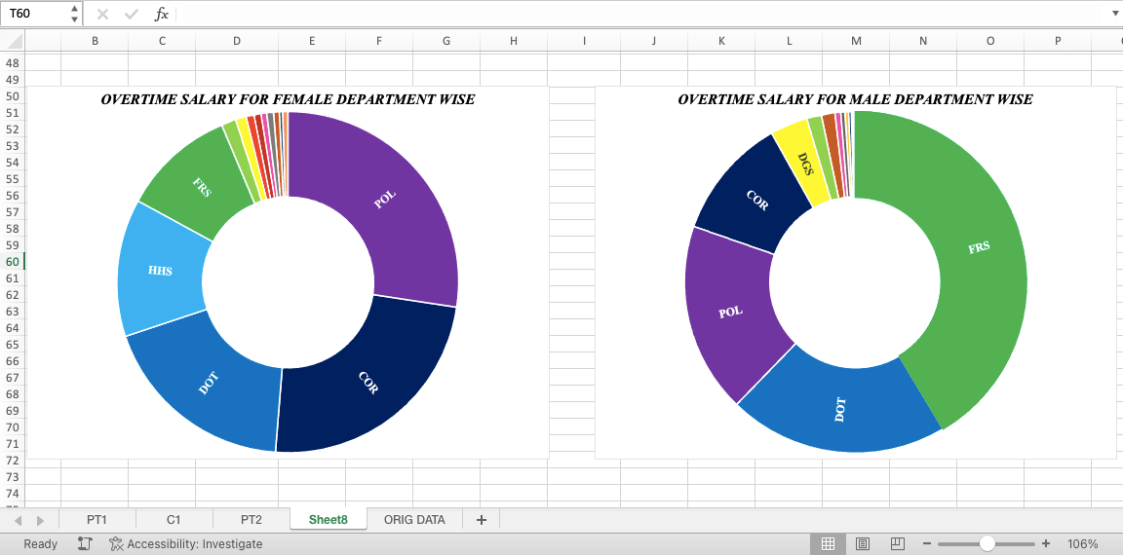
6. MODELLING APPROACH
DOUGHNUT CHART ANALYSIS - OVERTIME PAY

Slide 19
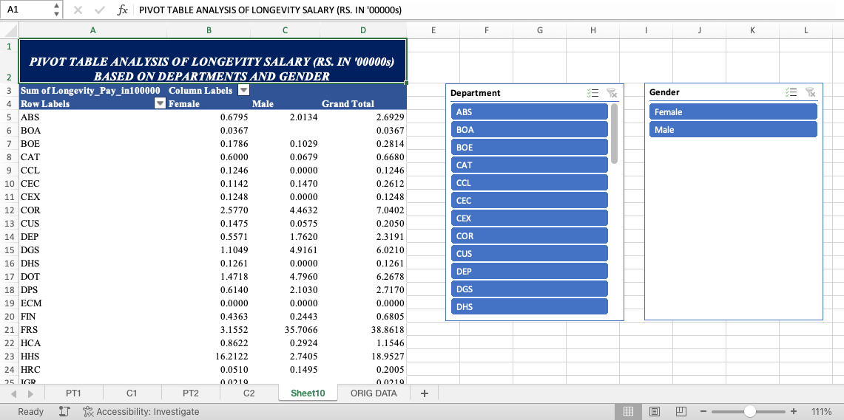
6. MODELLING APPROACH
PIVOT TABLE WITH SLICERS - LONGEVITY PAY

Slide 20
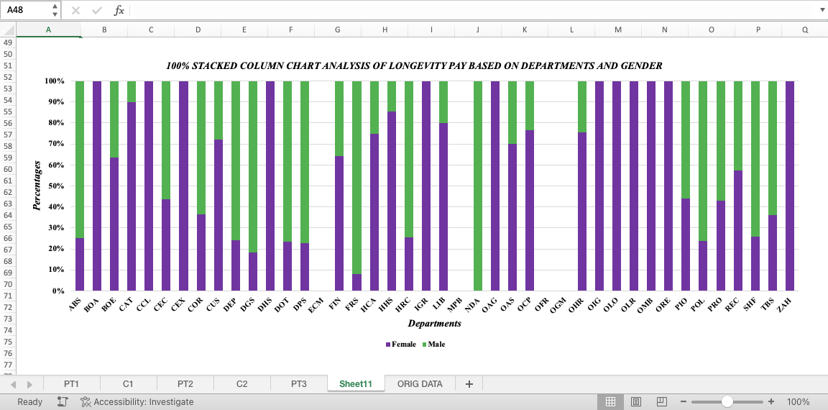
6. MODELLING APPROACH
100% STACKED COLUMN CHART ANALYSIS - LONGEVITY PAY

Slide 21
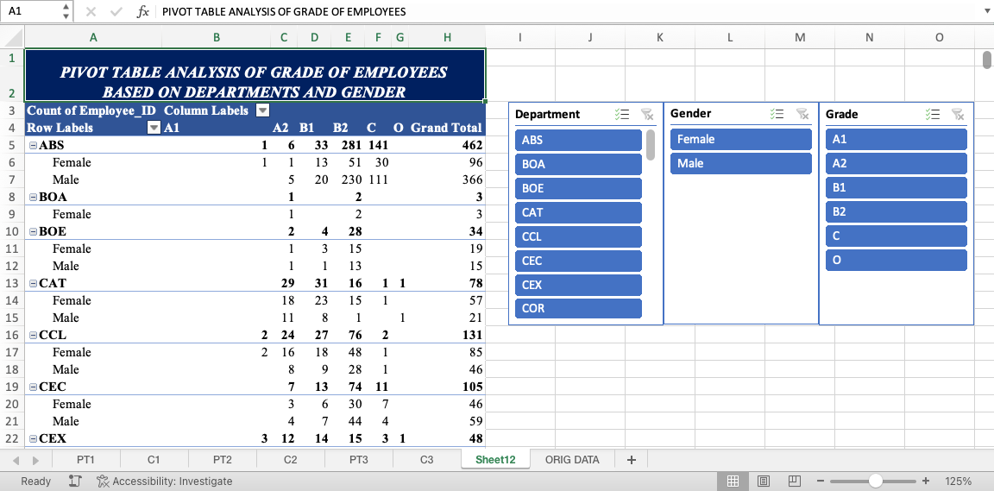
6. MODELLING APPROACH
PIVOT TABLE WITH SLICERS - GRADE OF EMPLOYEES

Slide 22
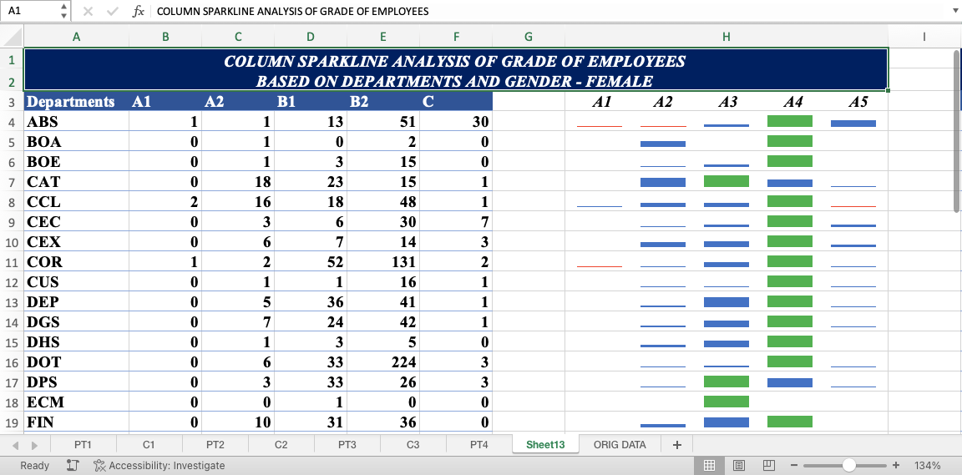
6. MODELLING APPROACH
COLUMN SPARKLINES GRADE ANALYSIS FOR FEMALE - ALL DEPT

Slide 23
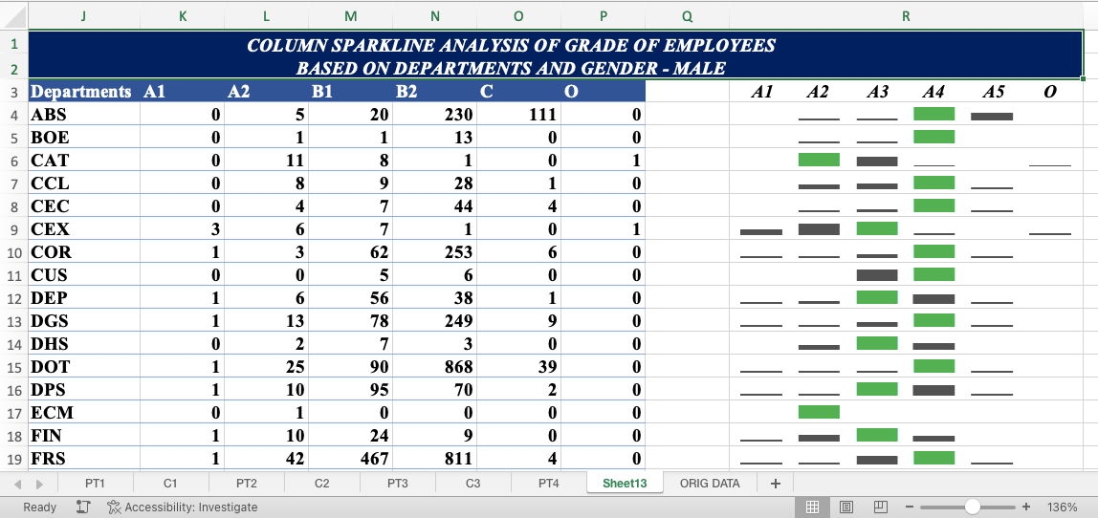
6. MODELLING APPROACH
COLUMN SPARKLINES GRADE ANALYSIS FOR MALE - ALL DEPT

Slide 24
7. RESULTS AND DISCUSSION
Important points derived from this analysis are:
As per the BASE SALARY (in total):
In Females, the maximum is from the HHS Department at Rs.1398.0796 Lakhs and the minimum is from the MPB Department at Rs.0.5391 Lakhs.
In Males, the maximum is from the FRS Department at Rs.1272.4698 Lakhs and the minimum is from the OFR Department at Rs.1.0200 Lakhs.
On comparison, we can infer in the base salary the minimum amount of the females is much lesser than that of the minimum amount of males.

Slide 25
7. RESULTS AND DISCUSSION
Important points derived from this analysis are:
As per the OVERTIME PAY (in total):
For Females, the Maximum amount of Overtime pay is Rs. 34.9451 Lakhs by the POL Department and the Minimum amount is Rs. 0.0032 Lakhs by the LIB Department.
For Males, the Maximum amount of Overtime pay is Rs. 291.5007 Lakhs by the FRS Department and the Minimum amount is Rs. 0.0034 Lakhs by the LIB Department.
Out of the 42 Departments, Overtime Pay is not present in 14 and 17 Departments for Females and Males respectively.
The LIB Department gives the least amount of Overtime Pay for both Males and Females.
The gap between the maximum amount based on gender is huge.

Slide 26
7. RESULTS AND DISCUSSION
Important points derived from this analysis are:
As per the LONGEVITY PAY (in total):
For Females, the Maximum amount of Longevity pay is Rs. 16.2122 Lakhs by the HHS Department and the Minimum amount is Rs. 0.0068 Lakhs by the OLO Department.
For Males, the Maximum amount of Longevity pay is Rs. 43.0676 Lakhs by the POL Department and the Minimum amount is Rs. 0.0287 Lakhs by the OAS Department.
Out of the 42 Departments, Longevity Pay is absent in 5 and 16 Departments for Females and Males respectively.
The gap in the Longevity Pay absenteeism is more in Males as compared to Females.
The Maximum Longevity Pay on the whole is given to the Male.

Slide 27
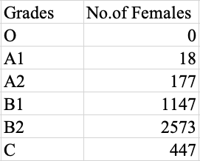
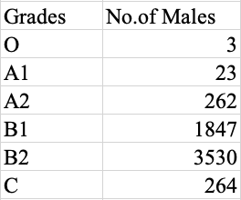
7. RESULTS AND DISCUSSION
Important points derived from this analysis are:
As per the GRADE OF THE EMPLOYEES (in total):
Out of the 10291 employees in the organisation, only 3 Employees are O Graders (Salary above Rs. 2,00,000) and all of them are Male.

Slide 28
8. CONCLUSION
We see that the Data Analysis is carried out using Excel, and we can derive meaningful and useful results.
On the Analysis done on the Base Salary, Overtime Pay, Longevity Pay and Grade of the Employees based on the Salaries the following conclusion can be made:
On a total basis, even though the Base Salary is maximum for Females, the Overtime Pay and the Longevity Pay are higher for Males as compared to Females by a large margin.
The O Graders are very few and all are Male, which means the organisation is having no Female Employees whose Salary is above Rs.2,00,000.
The Organisation can take various steps, plans, policies and programmes to improve the pay for the females and make it equal to that of the males.

Slide 29

Thank you very much!
By - Divyashree.S
Reg No – 312216323
III Year B.Com [General] – B Shift 2
For Naan Mudhalvan Course
Shri Shankarlal Sundarbai Shasun Jain College for Women.

